Slide 1

The psychometrics of Likert surveys: Lessons learned from analyses of the 16pf Questionnaire
Alan D. Mead

Slide 2
Measures are just measures, right?
One measurement theory (CTT or IRT or g theory, etc.) for all types of measures
I thought so, before I started teaching at IIT
But the “devil’s in the details” and these details vary considerably
  “Getting started” and Item writing
  Item analysis
  Implementation
I will use the 16pf as an example; most of these points are true for all Likert instruments

Slide 3
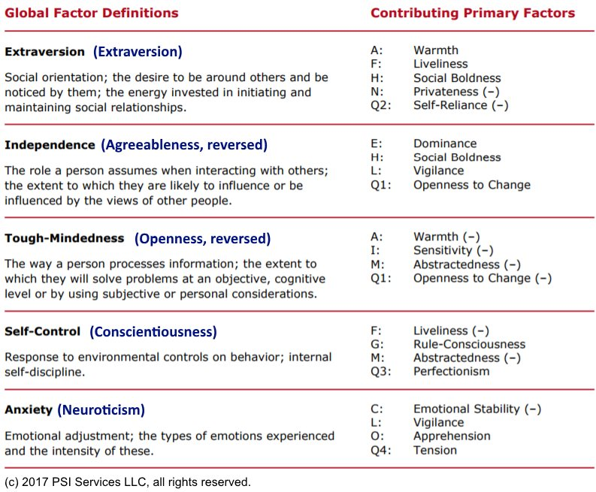

Slide 4
16pf6 Planned Improvements
Shorter, more reliable Likert scales
Adaptive Reasoning/B scale
Improved inattention validity index
Updated norms
Measuring the same factor structure as 16pf5
Gender neutral reports
Even better support for organizational applications

Slide 5
Everything we know about writing personality/Likert items
Get it? This page is BLANK!
(Funny joke,
but not actually
a laughing matter!)

Slide 6
Seriously, what we know about writing personality/Likert items
Most item writing guidance is (explicitly) designed for ability testing:
  Rule 1: Use either the best answer format or the correct answer format
  Rule 11: Avoid cuing one item with another; keep items independent of one another
Many guidelines are trivial/common sense
  Rule 4: Allow time for editing and other types of item revisions
  Rule 5: Use good grammar, punctuation, and spelling
Some guidelines are bad advice
Finally, a very few guidelines actually apply
Existing guidance either ignores Likert-specific issues…

Slide 7
Seriously, what we know about writing personality/Likert items
Most item writing guidance is (explicitly) designed for ability testing:
Many guidelines are trivial/common sense
Some guidelines are bad advice
  Rule 22: Word the stem positively; avoid negative phrasing.
Finally, a very few guidelines actually apply
  Rule 35: Avoid specific determiners, such as “never” and “always”
Existing guidance either ignores Likert-specific issues or is based on weak empiricism (“So-and-so found that 4-options scales were optimal [by some unstated criteria], so use those.”)

Slide 8
Scoring and Item Analysis
Generally, Likert items have “directions” rather than correct answers
Consider these Emotional Stability items:
  “I rarely feel blue” (positively worded)
  “I have days where I just cannot cope.” (negatively worded)
The “direction” would be reversed for Neuroticism
  These “are” both Emotional Stability and Neuroticism items

Slide 9
Scoring and Item Analysis (cont.)
Several unique aspects of item analysis
  Item mean is not very important
  Corrected item-total correlation (CITC) is critical
  CITC should be greater than cross-scale correlations
  Factor analysis (item loading) may be important
  Greater concern about item homogeneity
Scales tend to be far shorter (3 items!?!)
  But individual items are informative
  But may preclude analyses requiring long scales

Slide 10
IRT Analysis
Much greater variety of statistical models
  Linear models (SEM) and non-linear models (IRT)
  Various ordinal models (GRM, GPCM)
  Nominal polytomous models (Nominal model)
  Multidimensional models
  Ideal-point models (above are all dominance models)
Calibration issues
  Larger N required for polytomous models
  Some response options cannot be fit
  Short scales preclude asymptotic chi-square tests of fit

Slide 11
IRT Analysis (cont.)
Items have far greater Information
  Which increases with more response points (to some limit)
Perversely, Information is less important
  Item have wide Information
Less motivation to use “IRT scoring”
  Item “difficulty” not a significant issue
  CTT Likert scoring is generally good enough
  Short scales may damage theta-hat estimates

Slide 12
Administration
Traditional CAT has far less value
  MCAT makes more sense
  Strong preference for multiple items/screen
More formatting choices
  Traditional horizontal “scale” format; Vertical
  Technologically enhanced formats like sliders
Choice of response scales
  How many points? (4-7?) Include a midpoint?
  Forced-choice (“team player” or “talkative”?)
  Choice of anchors (agreement, frequency, etc.)

Slide 13
Usage and Validity
Reporting issues
“Score security” (differing threats)
Effects of bi-polarity
Validity
  Greater care must be taken to ensure content validity
  Criterion-related validities are more modest
  Construct validity may be more important

Slide 14
Thank You!
Questions?
amead@alanmead.org

